Slide 1
Team Collaboration using Git and GitHub

Slide 2
Team Collaboration
Manage Team Members
Bug Tracking
Pull Requests
Code Review
Analytics
GitHub Wiki

Slide 3
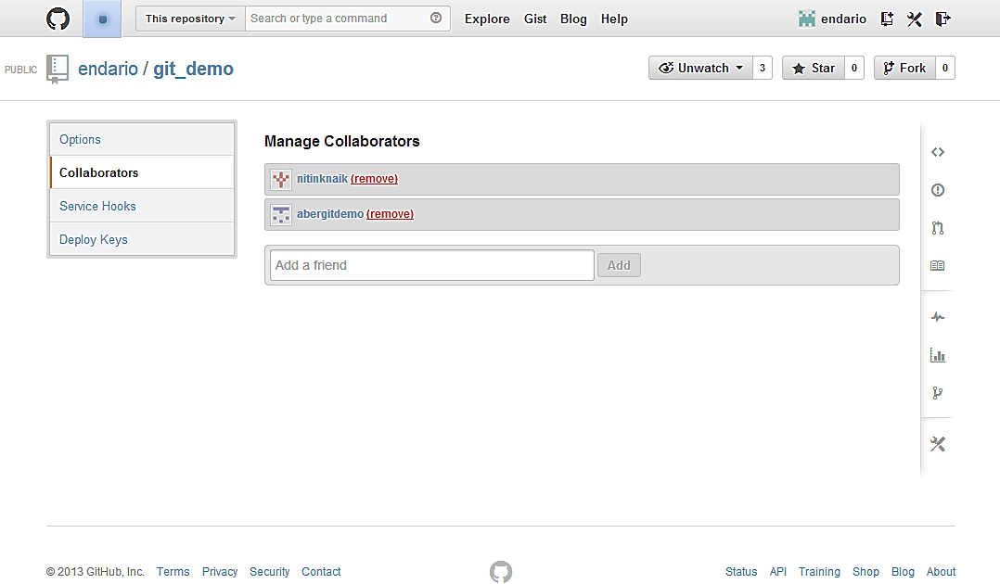
1. Manage Team Members
Settings > Collaborators > Add a friend

Slide 4
2. Bug Tracking
Bugs
Things that are obviously broken and need fixes
Features
Awesome cool new ideas to implement
To do list
A checklist of items to complete
Questions
Clarify misunderstandings

Slide 5
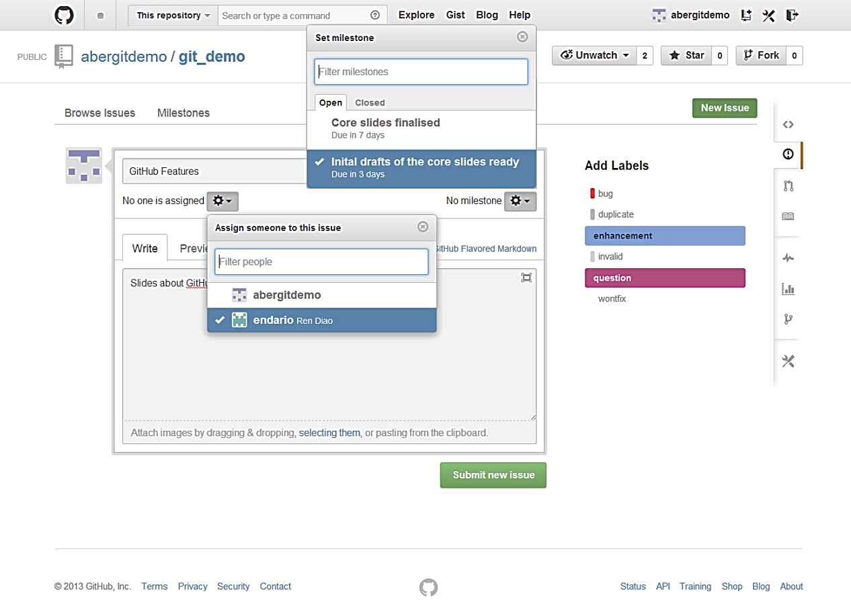
Open a New Issues
Milestone
Assignment
Labels
Notes:
Points to be made:
assign people
assign milestone (more later)
add labels (customisable)
people get email notifications so long being related to a given issue or @mentions.
you can mute the notifications

Slide 6
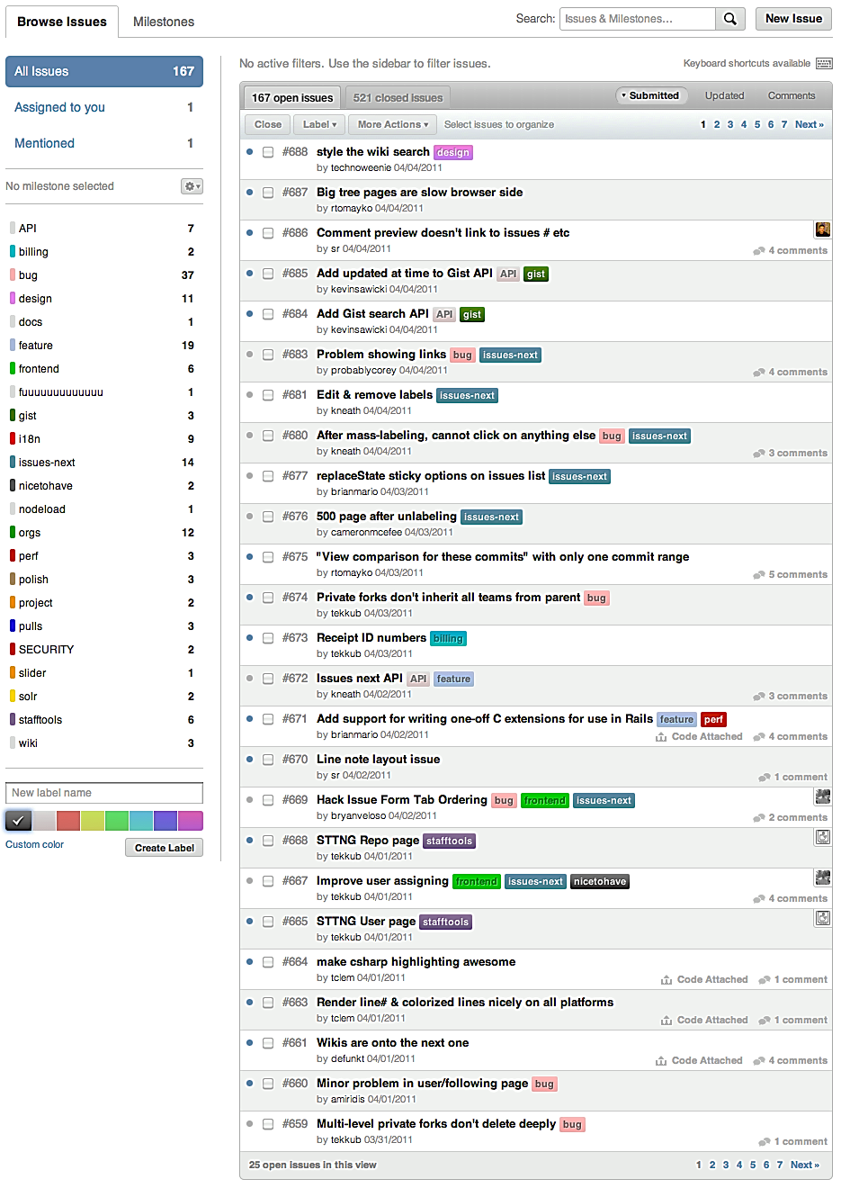
Navigating Issues
Search
Labels

Slide 7
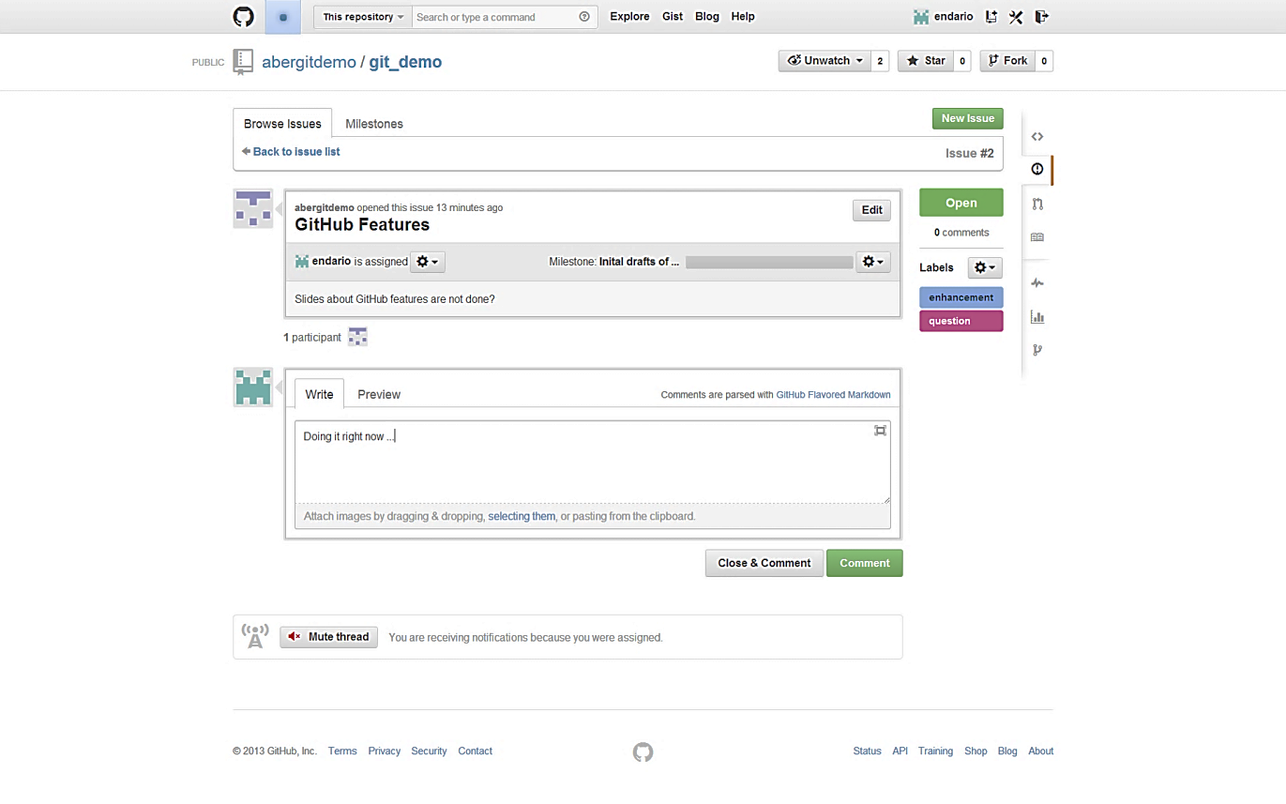
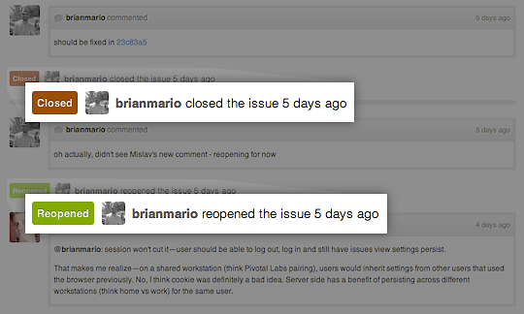
Closing & Re-Opening an Issue

Slide 8
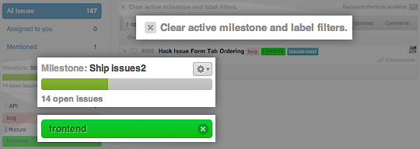
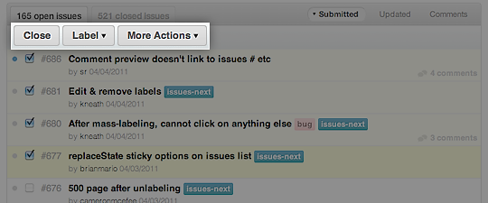
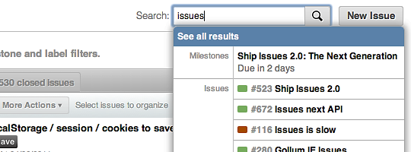
Working with Issues (1)
Filter by labels, milestones, etc.
Mass-editing: close, reopen, add labels, assign to users, etc.
Quick-search as you type, or open full search.

Slide 9
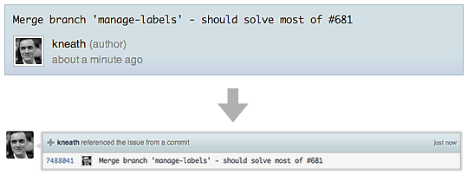
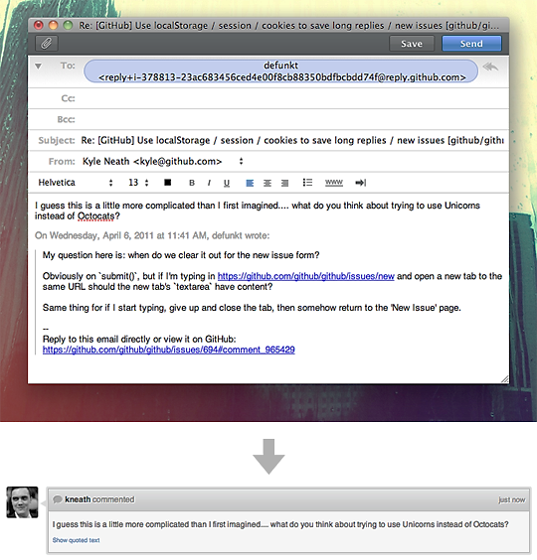
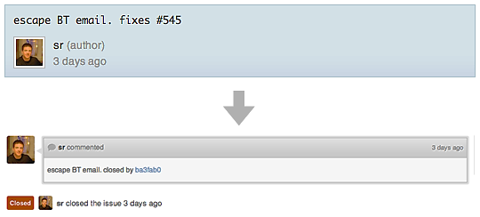
Working with Issues (2)
reference an issue from a commit message
close issue using commit
Reply by email

Slide 10
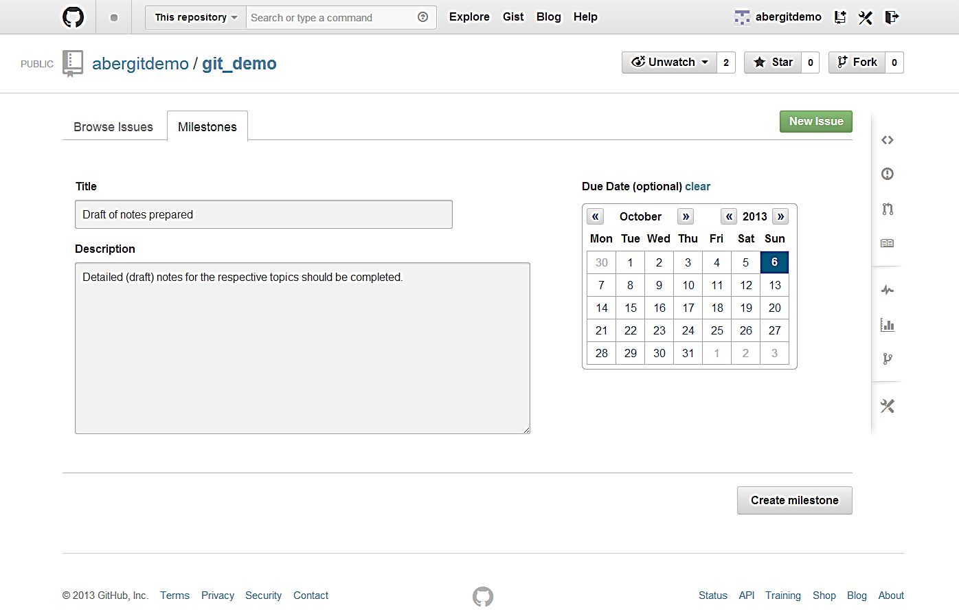
Create a New Milestone

Slide 11
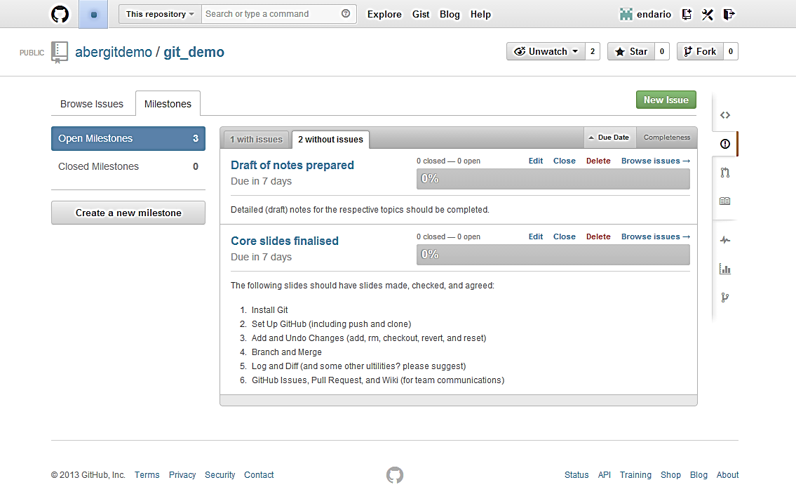
View Milestones

Slide 12
3. Pull Requests
Two types of collaborative models on GitHub
Fork & Pull Model
Used in a public repository for which we don’t have push access
Share Repository Model
Used in a private repository for which we have push access.
Fork is not required is this case.

Slide 13
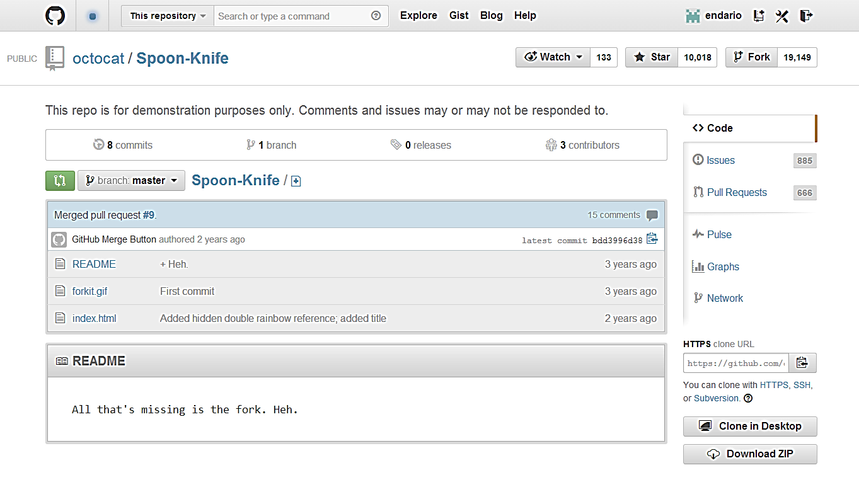
Fork & Pull Model
Forks are higher level ‘branches’ allowing isolated development on a collaborative project.
It also allows you to build a project using others as a starting point.

Slide 14
Clone a Fork and Configure Upstream
Clone your fork
Configure remotes
Pull in upstream changes
$ git clone https://github.com/endario/Spoon-Knife.git
Cloning into 'Spoon-Knife'...
remote: Counting objects: 24, done.
remote: Compressing objects: 100% (21/21), done.
remote: Total 24 (delta 7), reused 15 (delta 1)
Unpacking objects: 100% (24/24), done.
$ git remote add upstream https://github.com/octocat/Spoon-Knife.git
$ git fetch upstream
From https://github.com/octocat/Spoon-Knife
* [new branch] master -> upstream/master
$ git fetch upstream
# Fetches any new changes from the original repository
$ git merge upstream/master
# Merges any changes fetched into your working files

Slide 15
Modify Your Fork
Create branches
Push your commits
$ git checkout –b colour
Switched to a new branch ‘colour’
$ git commit -a -m 'modified index page with some colour and boldness'
[master d5a7377] modified index page with some colour and boldness
1 file changed, 7 insertions(+), 1 deletion(-)
$ git push origin colour
Username for 'https://github.com': endario
Password for 'https://endario@github.com':
Counting objects: 5, done.
Delta compression using up to 4 threads.
Compressing objects: 100% (3/3), done.
Writing objects: 100% (3/3), 396 bytes | 0 bytes/s, done.
Total 3 (delta 2), reused 0 (delta 0)
To https://github.com/endario/Spoon-Knife.git
bdd3996..d5a7377 colour -> colour

Slide 16
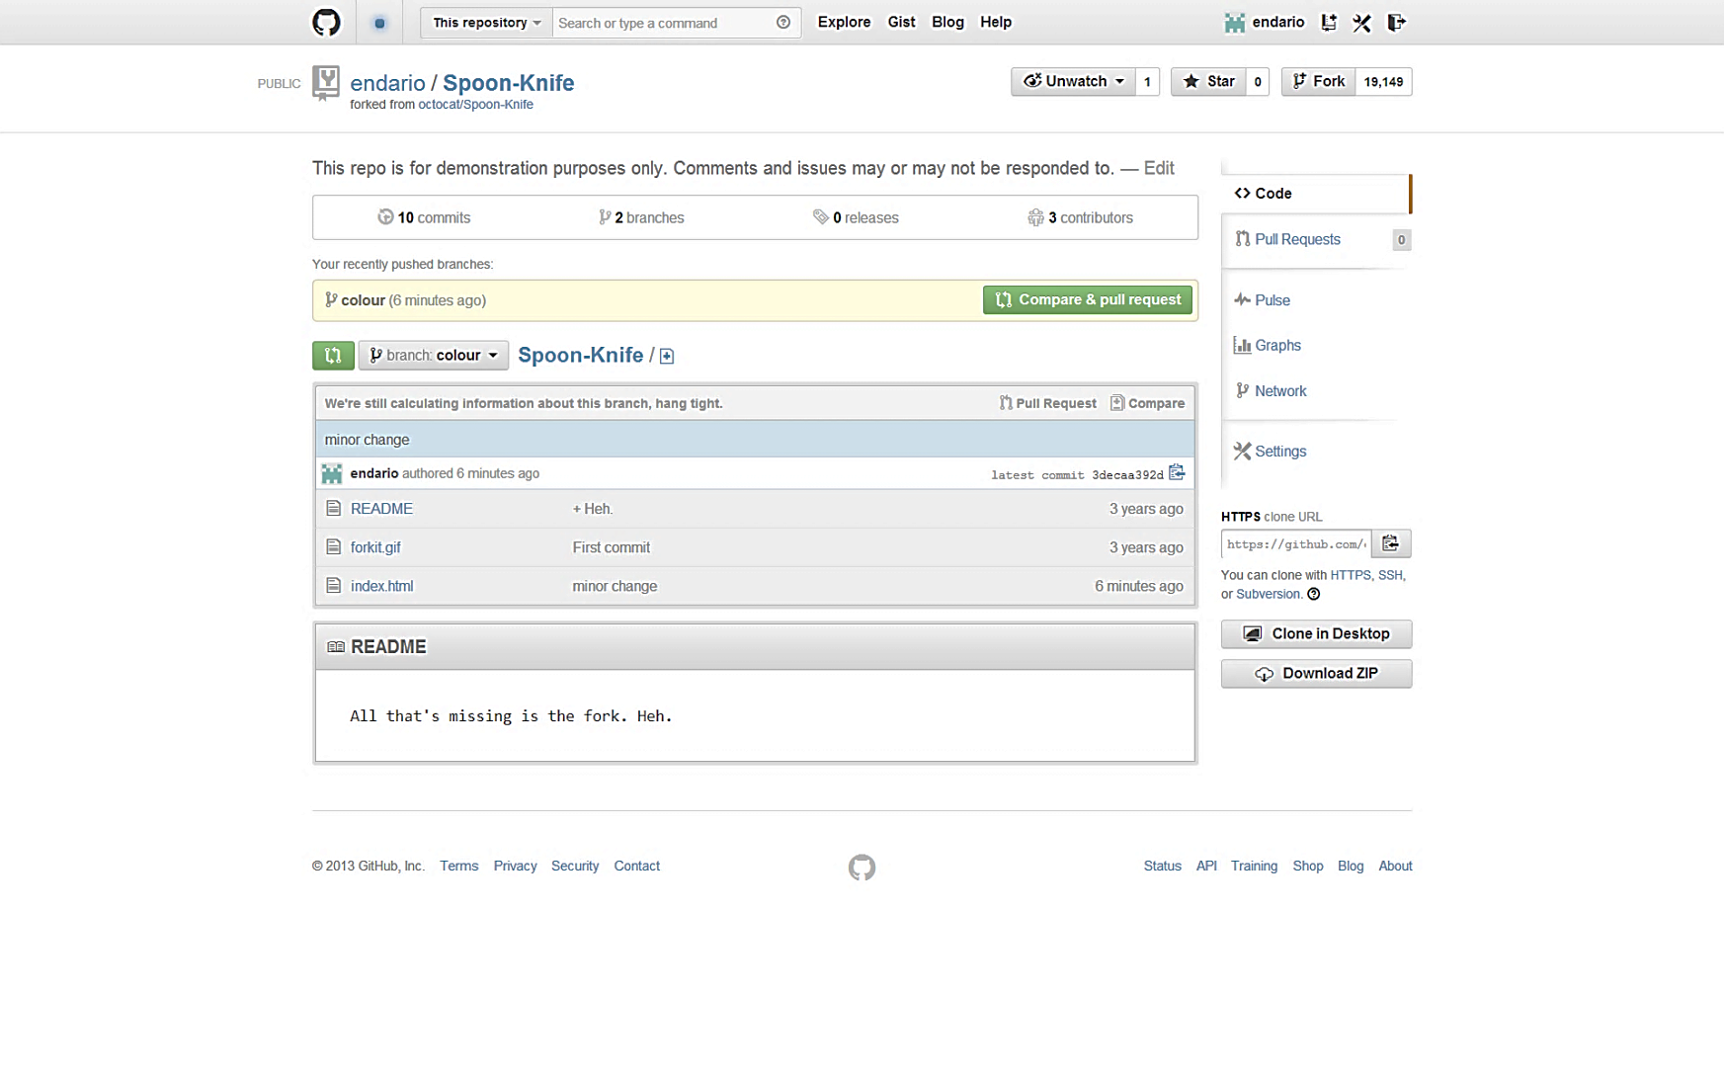
Initiate a Pull Request
Once you’ve made a few commits, you would like someone to review and merge. Navigate to your repository with the changes you want someone else to pull, and press the Pull Request button.

Slide 17
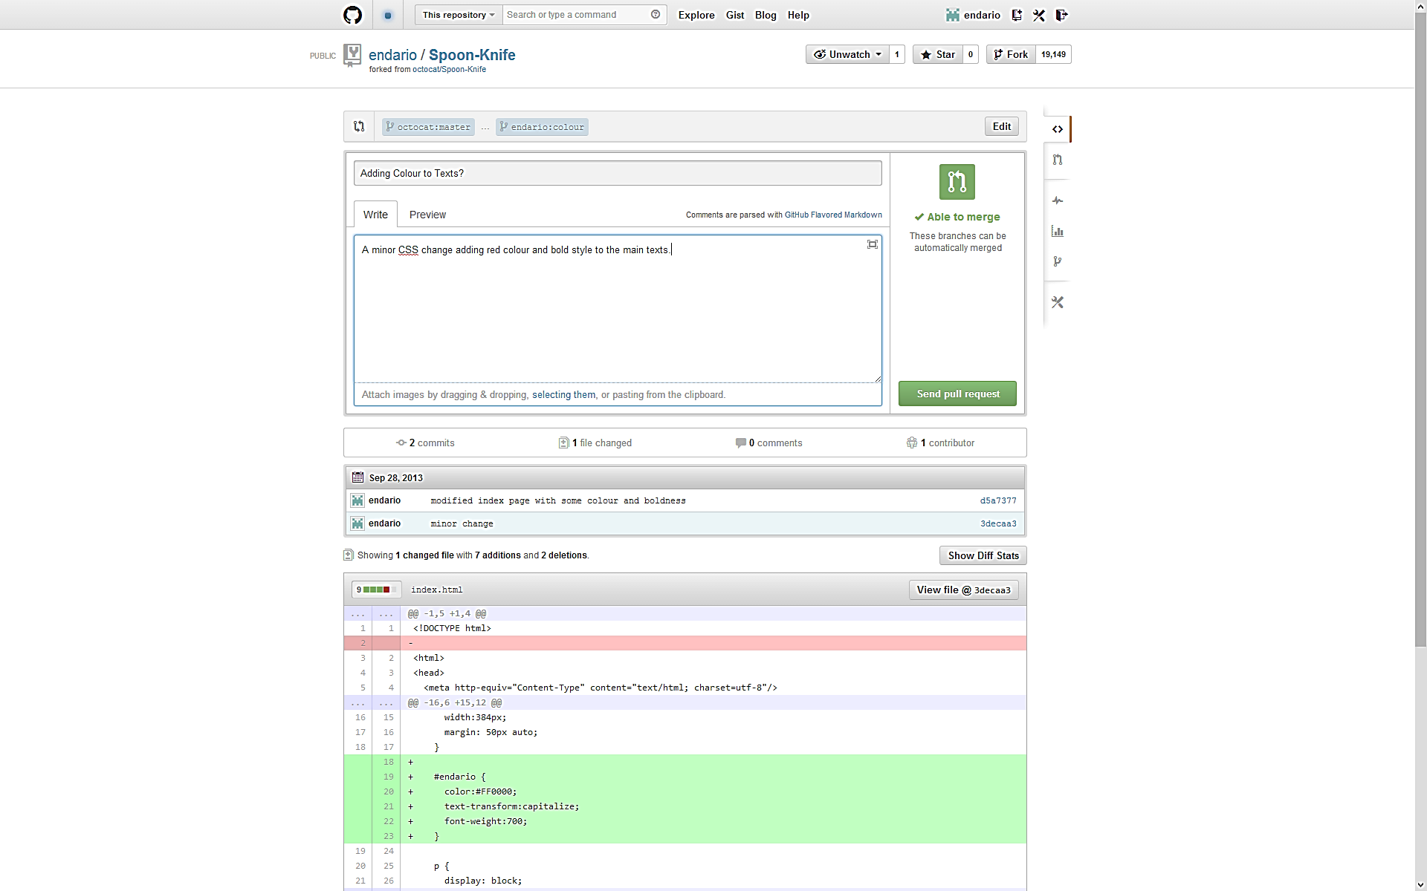
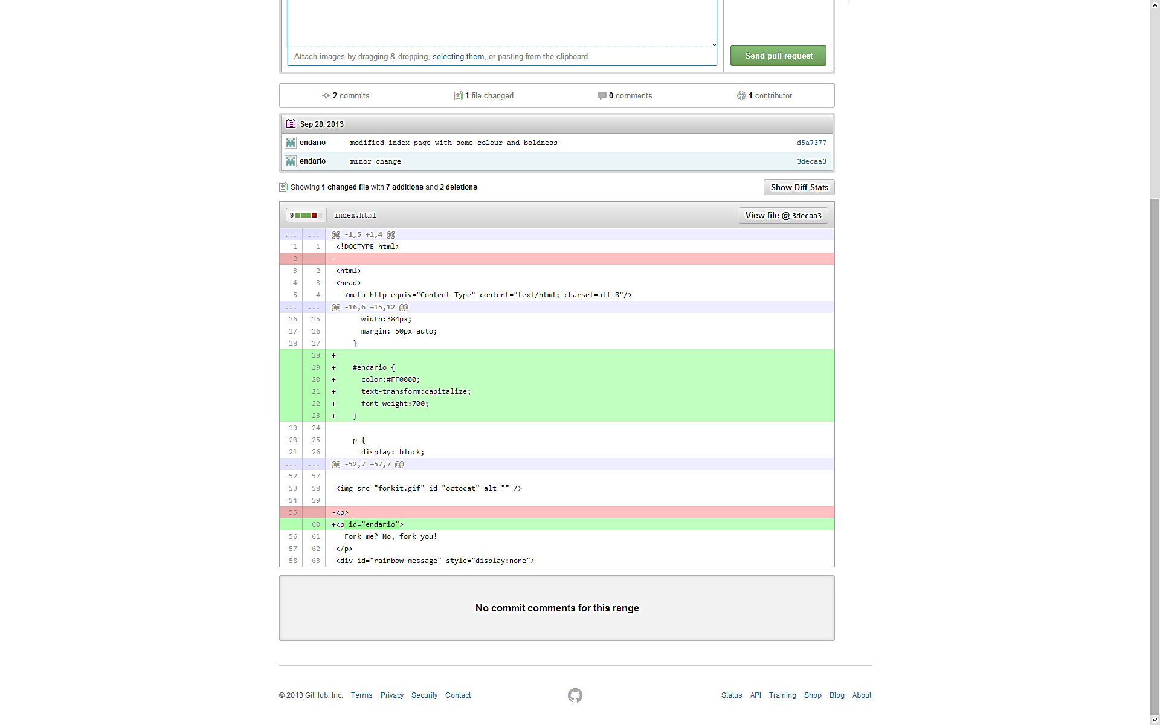
Review a Pull Request
You are then presented with a review page where you can get a high-level overview of what exactly has changed between your branch and the repository's master branch.

Slide 18
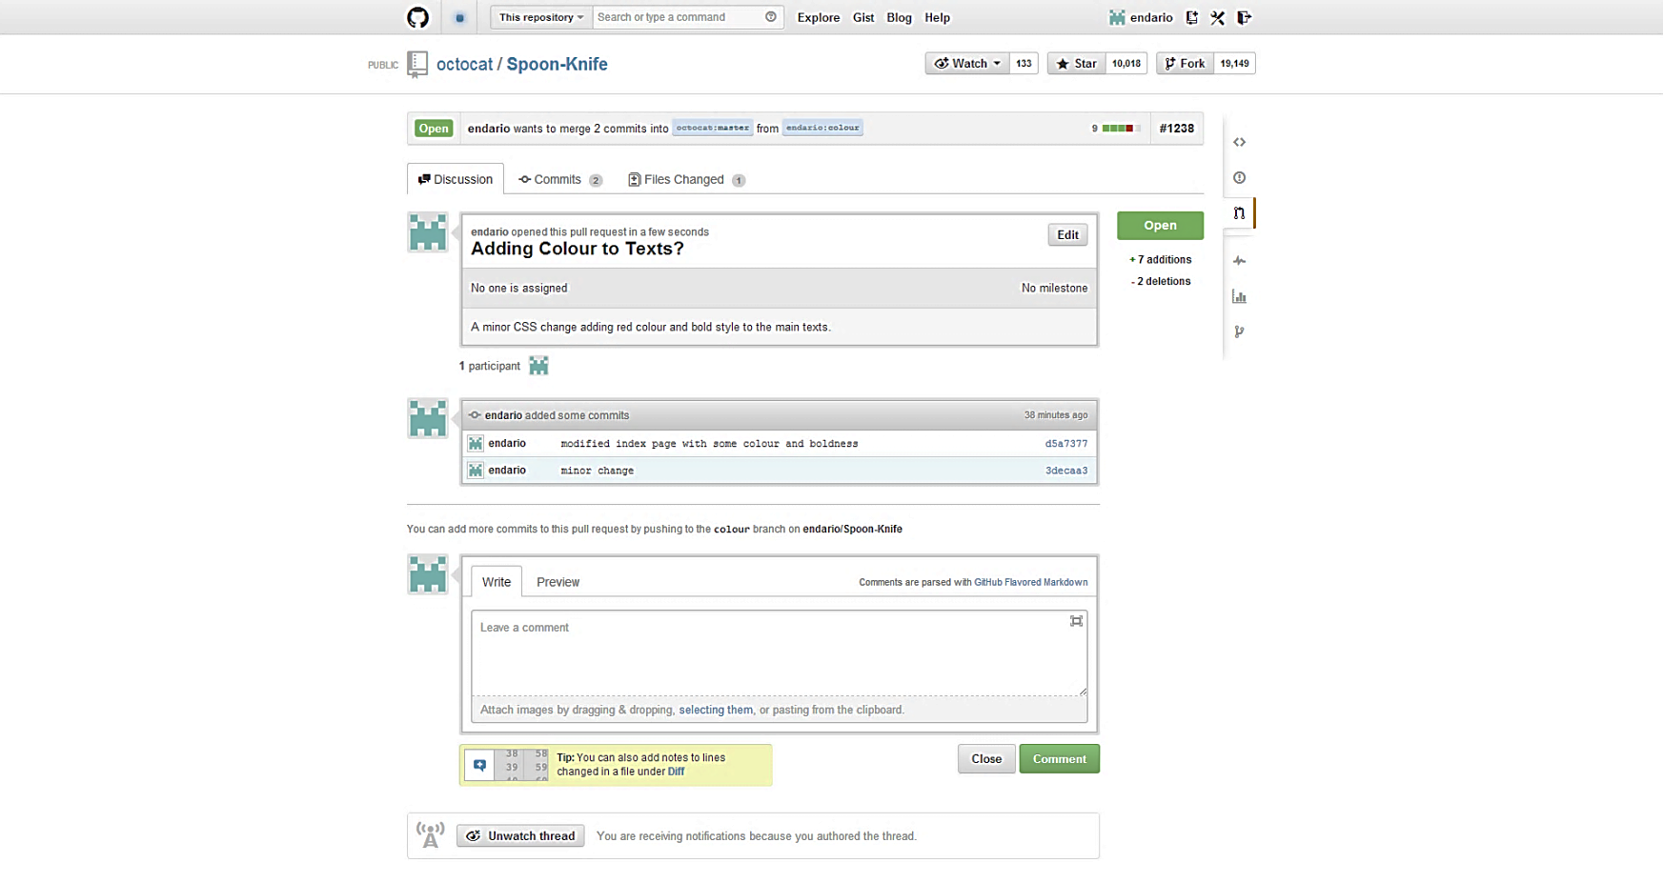
Send a Pull Request
You are then presented with a review page where you can get a high-level overview of what exactly has changed between your branch and the repository's master branch.

Slide 19
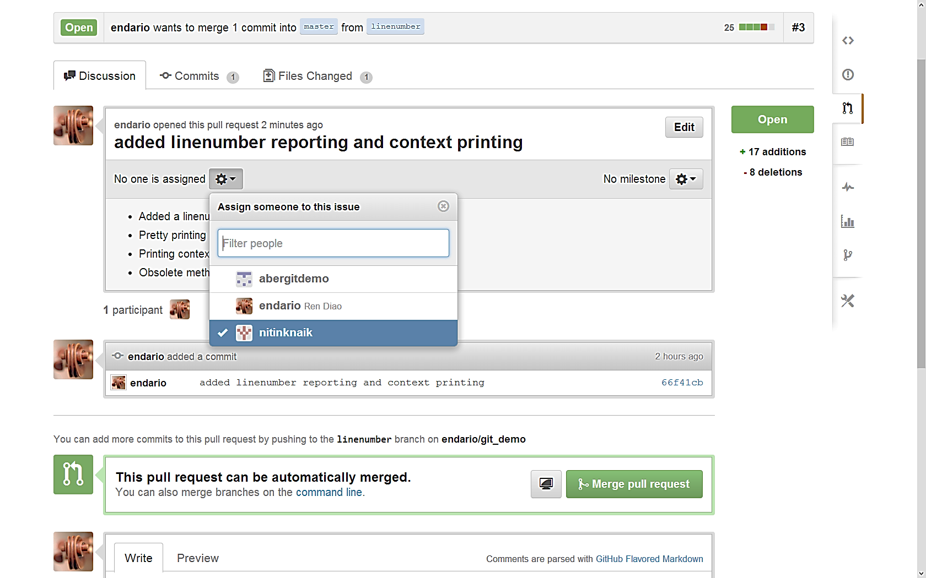
4. Code Review
You may assign a team member to a pull request, asking them to review the changes, working exactly like an issue.

Slide 20
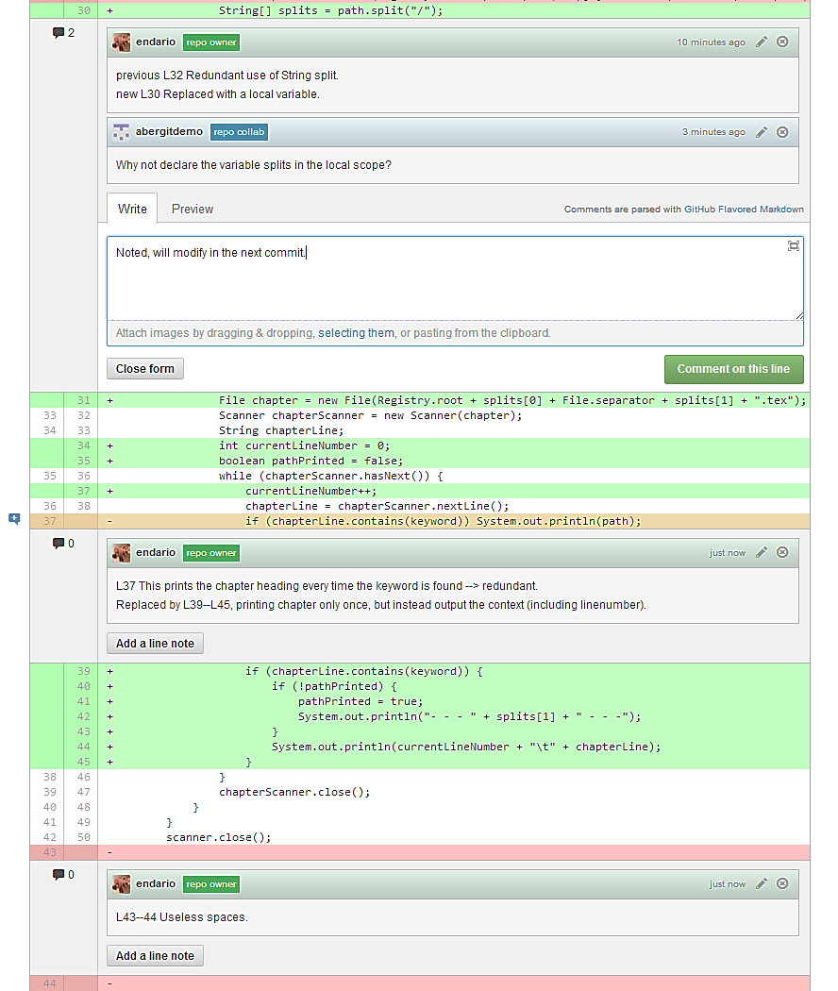
In-line Comment and Discussion
Notes:
Add comments (and discuss changes) on a line-by-line basis.

Slide 21
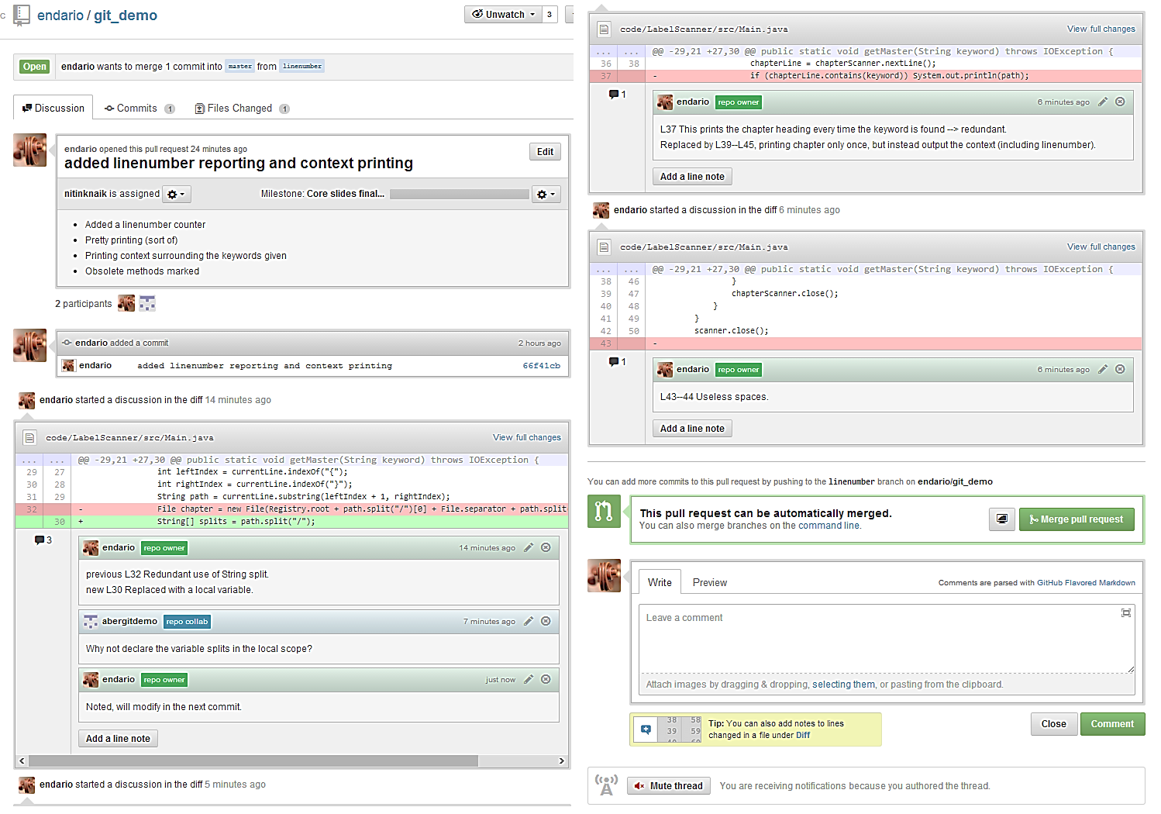
Review and Merge Changes

Slide 22
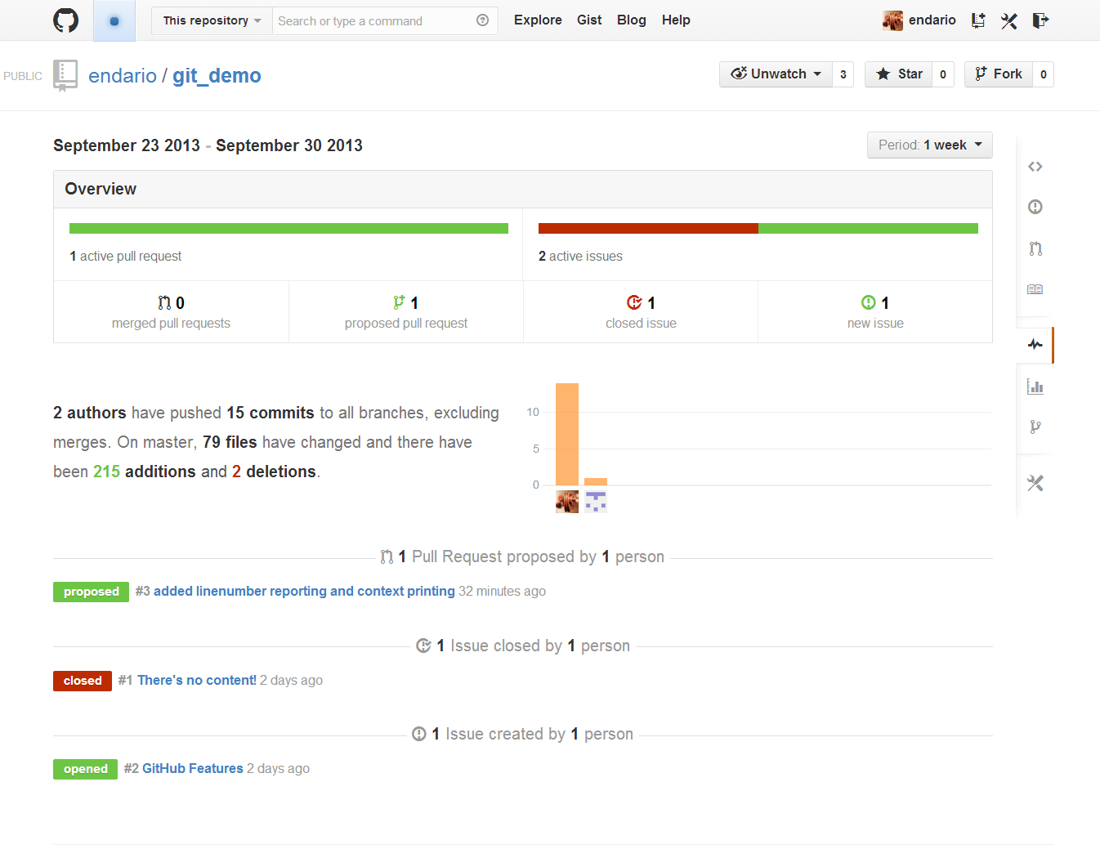
5. Analytics
GitHub Pulse presents a high level summary of the repository activities.

Slide 23
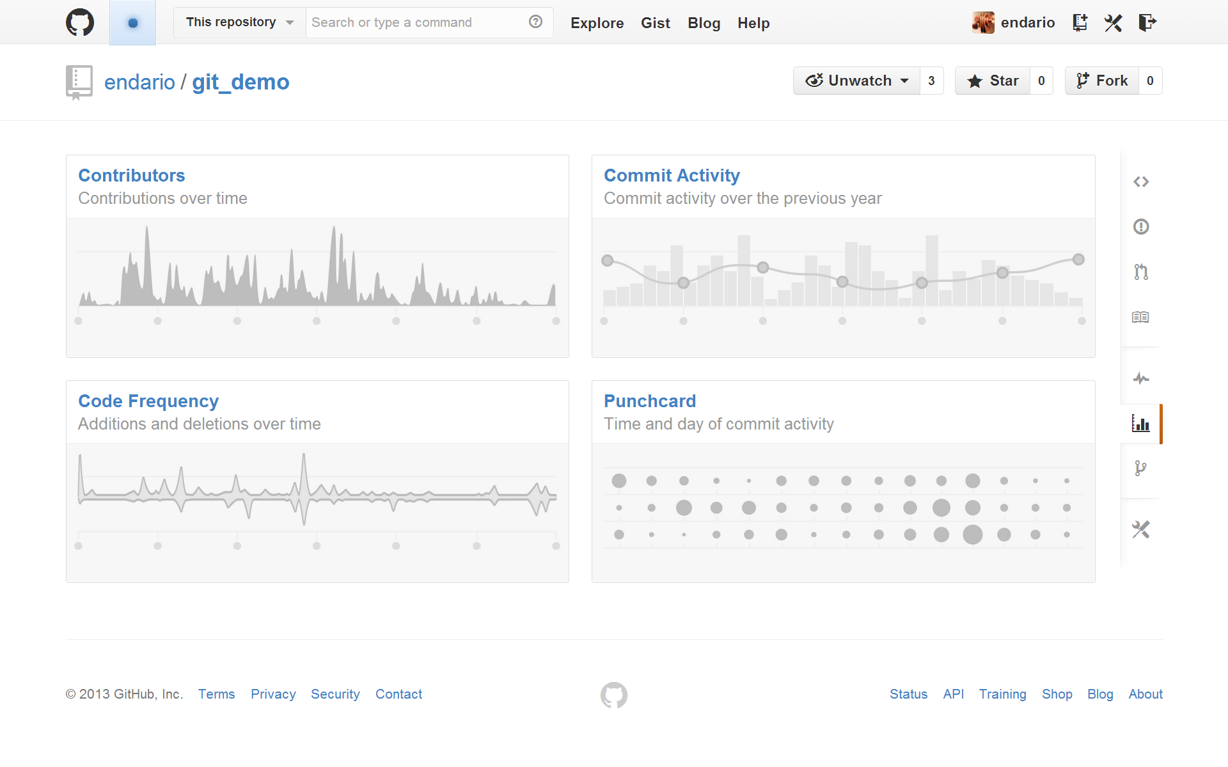
Graphs
GitHub Graphs provide insights into the collaborators and contributions behind each code repository.

Slide 24
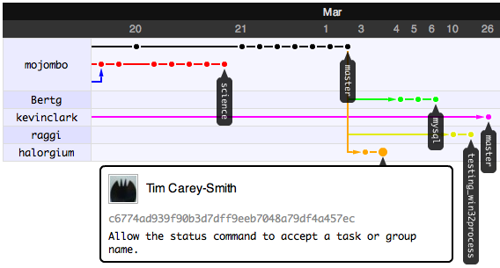
Network
GitHub Network provides a visualization on each contributors and their commits across all branches / forked repositories.

Slide 25
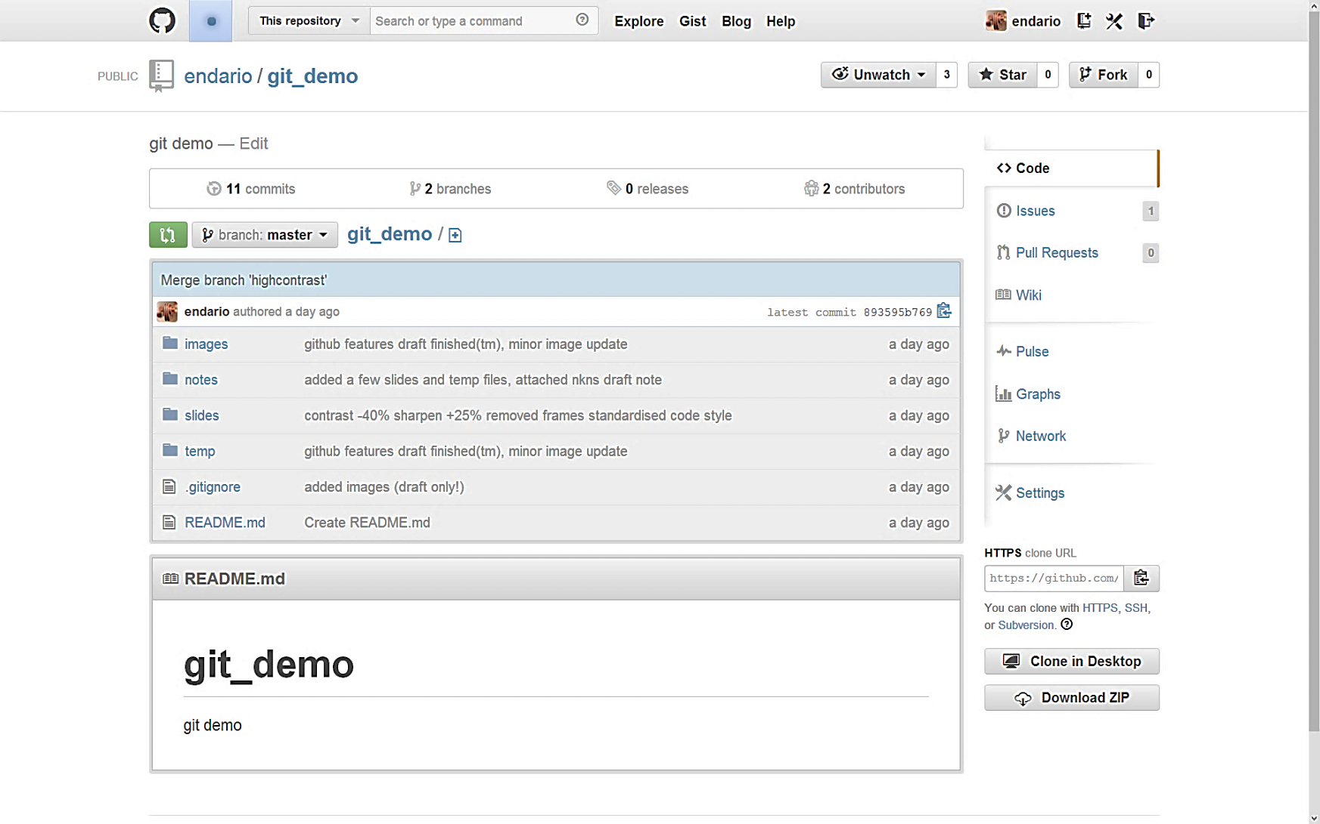
6. GitHub Wiki

Slide 26
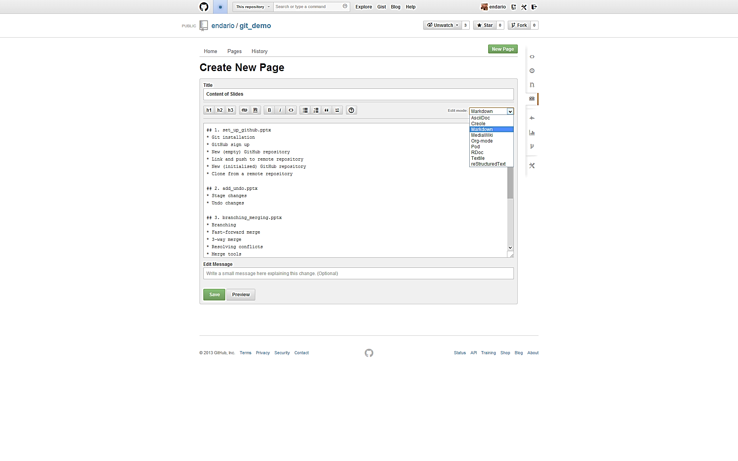
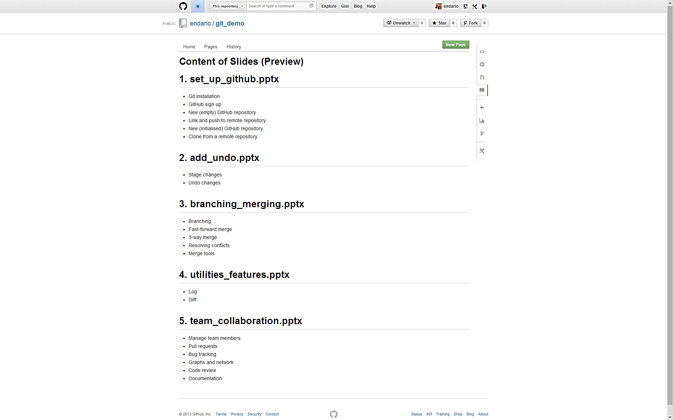
Edit and Preview New Wiki Page

Slide 27
Recommended Readings
http://net.tutsplus.com/articles/general/team-collaboration-with-github/
https://github.com/features/projects/
https://help.github.com/articles/github-flavored-markdown

